Slide 1

Fall Detection System Using Sensors Embedded In Smartphones
By,
Jathin Sreenivas,
Vineeth Bhat,
Vidya Gopalakrishnarao

Slide 2
Project Updates
Targeted group of people[1]:
Based on the literature we are referring, which considered 6 individuals of below mentioned age, weight and height group fall detection algorithm is defined.
Age group : 30 – 39 years
Weight group: 59 kgs – 72 kgs
Height: 1.68m – 1.76m
Types of falls : Forward, backward

Slide 3
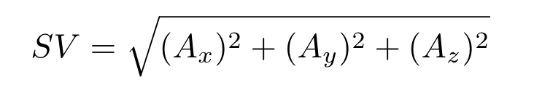

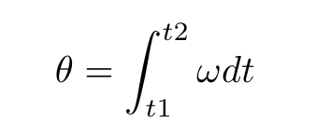
Calculations
Total Sum vector:
Angular velocity:
Tilt:

Slide 4
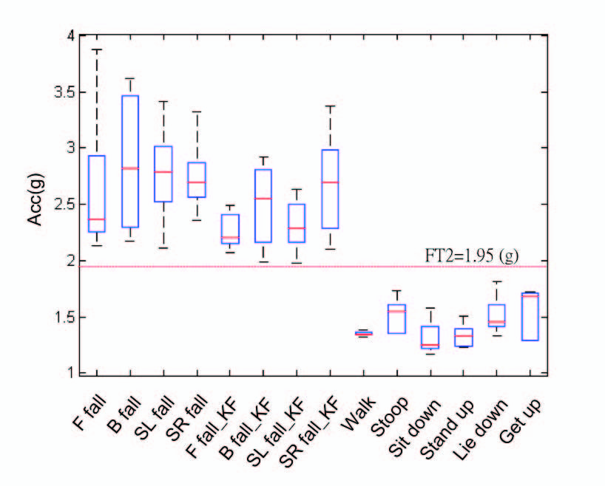
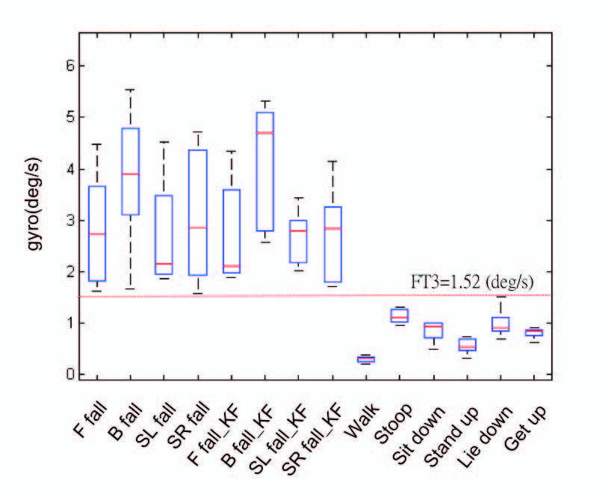
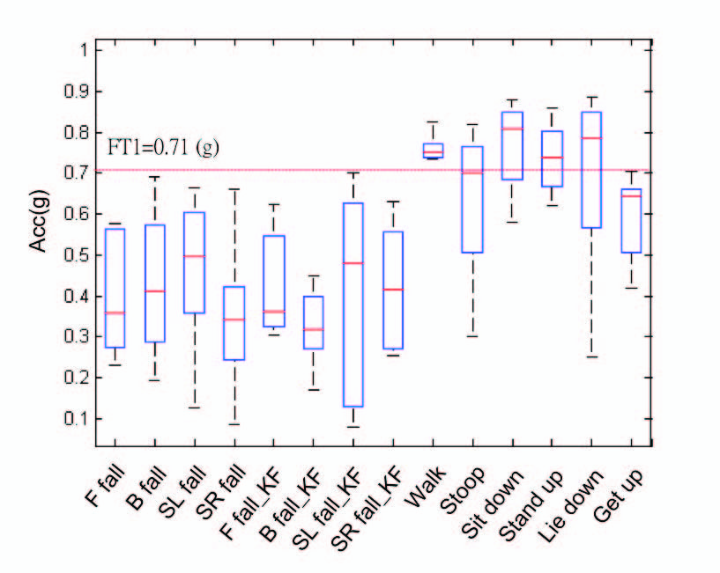
Defining thresholds for Fall Detection Algorithm
Thresholds are defined based on the experiment done on the literature on previously mentioned group of people.
FT1: Lower acceleration threshold: 0.71g
FT2: Upper acceleration threshold: 1.95g
FT3: Angular velocity: 1.52 deg/sec
FT4: Tilt: 60 degrees

Slide 5
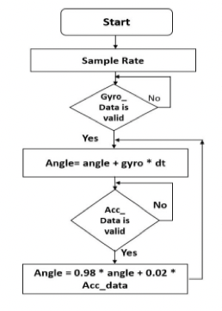
Complementary Filter
Filtered Angle = α × (Gyroscope Angle) + (1 − α) × (Accelerometer Angle)
α = T/(T + Δt) = Filter coefficient
(Gyroscope Angle) = (Last Measured Filtered Angle) + ω×Δt
ΔT = sampling rate
T = time constant greater than timescale of typical accelerometer noise

Slide 6
Updated Flowchart and Project progress
Update the calculation for angular velocity and tilt.
Defined the corresponding thresholds in the system.
Sensor fusion via complementary filter.
System developed to provide alert if the calculated values exceed the threshold.
Dataset obtained to perform testing for the targeted people[3].
Pending:
Testing based on the dataset.
Fixing minor bugs regarding alert and notifications.

Slide 7

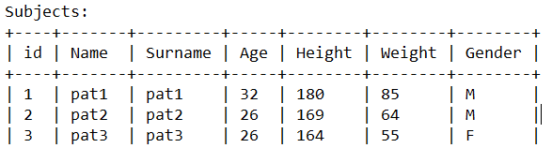
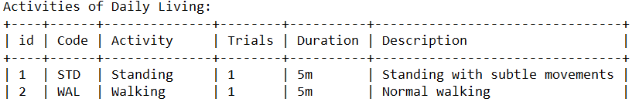
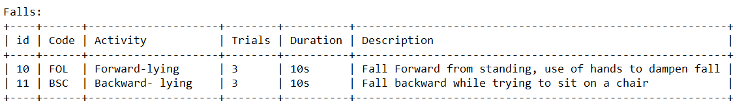
Data Sample

Slide 8
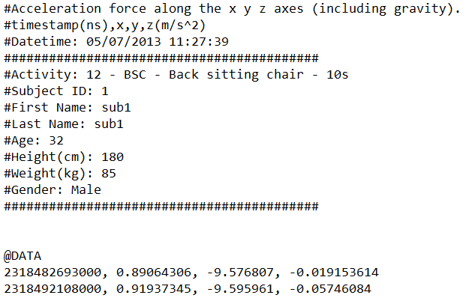
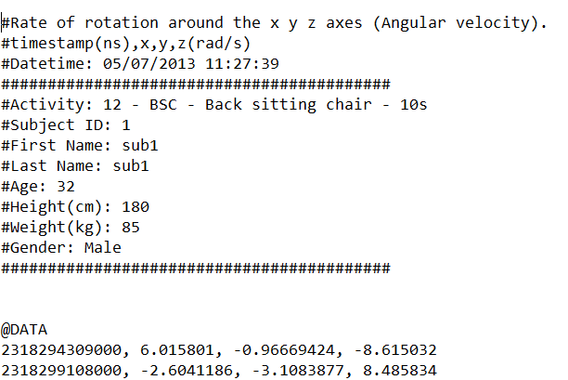

Slide 9
References
H. W. Guo, Y. T. Hsieh, Y. S. Huang, J. C. Chien, K. Haraikawa and J. S. Shieh, "A threshold-based algorithm of fall detection using a wearable device with tri-axial accelerometer and gyroscope," 2015 International Conference on Intelligent Informatics and Biomedical Sciences (ICIIBMS), Okinawa, 2015, pp. 54-57, doi: 10.1109/ICIIBMS.2015.7439470.
Android Sensor Fusion Tutorial. http://plaw.info/articles/sensorfusion/ paul lawitzki
G. Vavoulas, M. Pediaditis, E. G. Spanakis and M. Tsiknakis, "The MobiFall dataset: An initial evaluation of fall detection algorithms using smartphones," 13th IEEE International Conference on BioInformatics and BioEngineering, Chania, 2013, pp. 1-4, doi: 10.1109/BIBE.2013.6701629.
G. Vavoulas, M. Pediaditis, C. Chatzaki, E. G. Spanakis, M. Tsiknakis, The MobiFall Dataset: Fall Detection and Classification with a Smartphone, invited publication for the International Journal of Monitoring and Surveillance Technologies Research, pp 44-56, 2014, DOI:10.4018/ijmstr.2014010103.

